Slide 1
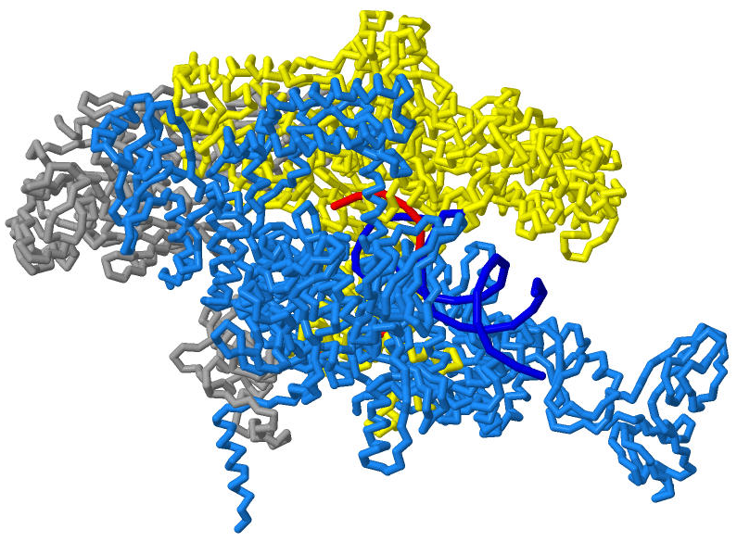
Bacterial RNA Polymerase New Insights on a Fundamental Molecular Machine
Students: Catherine Dornfeld, Christopher Hanna and Jason Slaasted
Instructor: Steven Forst , Ph.D. Mentor: Richard Gourse, Ph.D.

Slide 2
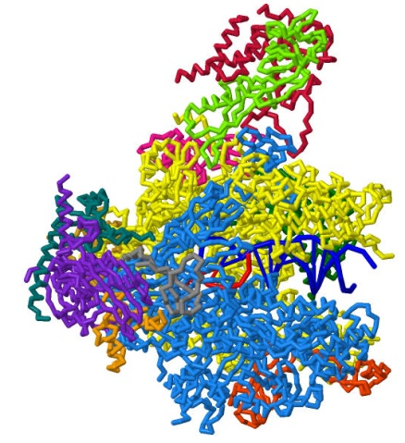
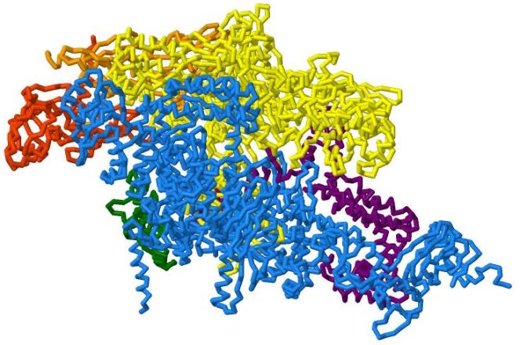
Comparison of RNA Polymerases
Bacterial RNAP
6 subunits (ααββ’ω)
2A6E
Eukaryotic RNAP
12 subunits
3PO2

Slide 3
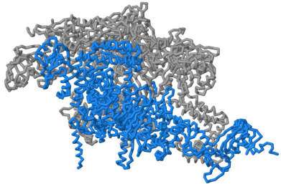
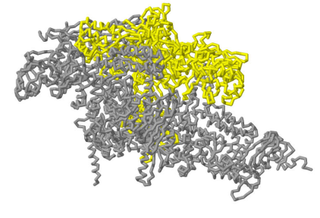
Bacterial RNA Polymerase
Composed of 6 separate subunits:
2α ω σ – Important for assembly and promoter recognition
β subunit – Contains RNA-exit channel and part of secondary channel
β’ subunit – Contains catalytic site, lid, bridge helix, trigger helix and part of secondary channel
β’ subunit
β subunit

Slide 4
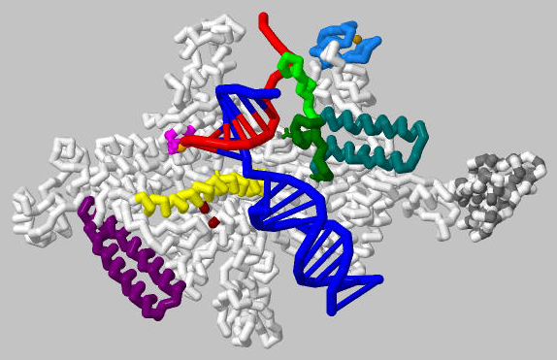
Beta prime subunit of Thermus thermophilus
Are functional structures of β’ conserved in other organisms?
Notes:
Mg

Slide 5
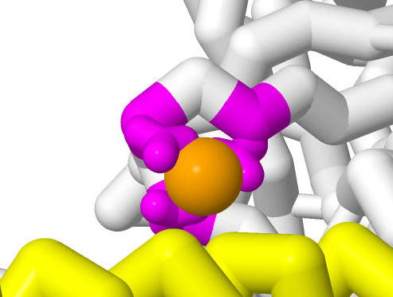
Catalytic Site (737-745)
T. thermophilus NADFDGDQM
E. coli NADFDGDQM 100% conserved
S. cerevisiae NADFDGDEM 89% conserved
Catalytic site is highly conserved in all three organisms
Aspartic acids highlighted are necessary for Mg+ binding

Slide 6
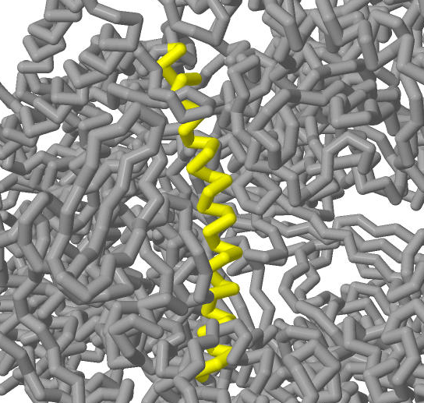
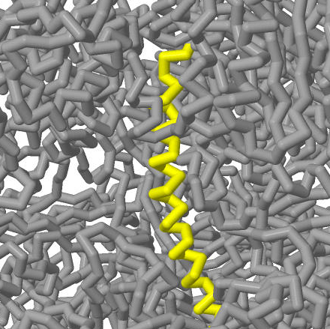
Bridge Helix (1067-1102)
T. thermophilus RSSFREGLTVLEYFISSHGARKGGADTALRTADSGYLTRKLV
E. coli TANFREGLNVLQYFISTHGARKGLADTALKTANSGYLTRRLV 76%
S. cerevisiae RNSFFSGLSPPEFLFHAISGREGLVDTAVKTAETGYMSRRLM 40%
T. thermophilus
S. cerevisiae
Sequence is divergent in eukaryotes but the structure is conserved between T. thermophilus and S. cerevisiae
Notes:
Remove DNA
1088,1092,1096

Slide 7
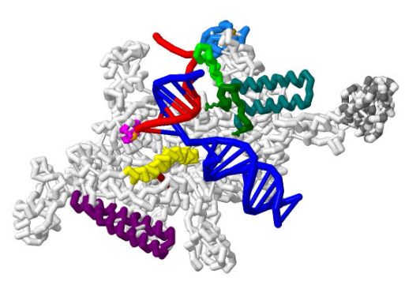
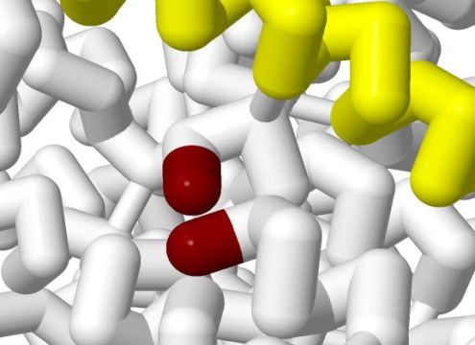
Trigger Loop (1236-1255)
Not crystallized in this model but positioning residues are colored
T. thermophilus VAAQSIGEPGTQLTMRTFHTGG
E. coli IAAQSIGEPGTQLTMRTFHIGG 91%
S. cerevisiae IGAQSIGEPGTQMTLKTFHFAG 68%

Slide 8
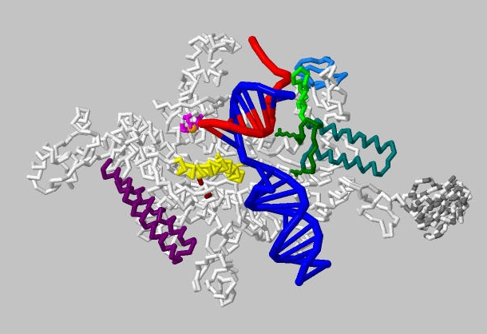
The Model: β’ Subunit
Contains the catalytic site of RNA polymerase along with structures to support this function.
When DNA enters RNAP, a kink is formed as the strands separate.
There is 1 Mg²⁺ in this model, but 2 Mg²⁺ exist.
Channel dimensions:
Incoming DNA: 20 Å
Secondary: 11 Å
Exit: 16-19 Å
RNA-DNA hybrid helix
Downstream DNA double helix
Notes:
1. Chelated to 3 conserved Asp residues in the active site
2. Coupled to the incoming NTP
Trigger loop not in model
Times New Roman

Slide 9
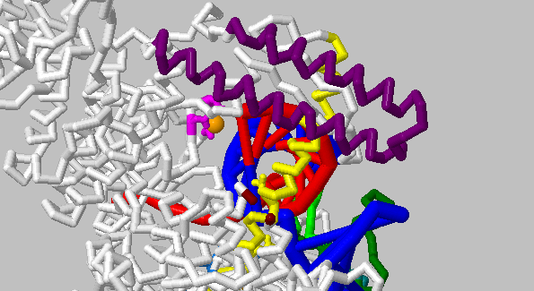
Following NTP Through β’
The incoming NTP first encounters the rim helices bordering the secondary channel.

Slide 10
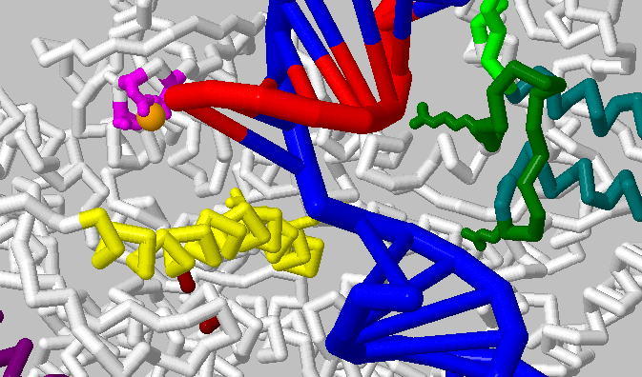
Following NTP Through β’
The NTP coupled to Mg²⁺ moves down the secondary channel to meet the DNA at the kink.
Notes:
Diffusing at rapid rate

Slide 11
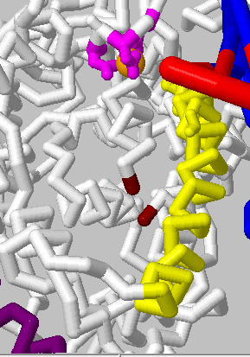
Following NTP Through β’
PREINSERTION STATE:
The trigger loop has not yet associated with the bridge helix to become the trigger helix.
INSERTION STATE:
The trigger helix guides the NTP into the correct orientation for addition.
Notes:
Mention preinsertion = before catalysis, insertion = catalysis

Slide 12
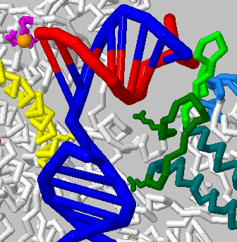
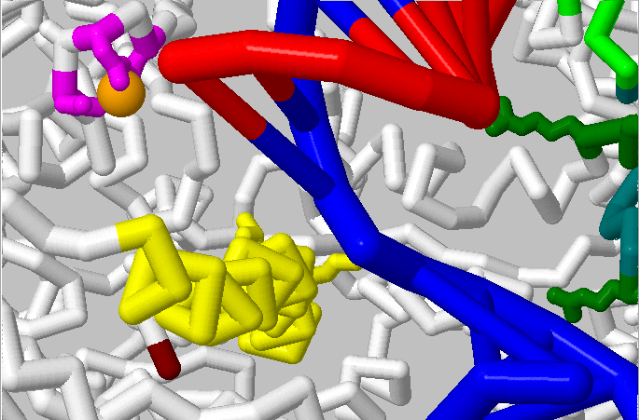
Following NTP Through β’
The NTP approaches the acceptor template base in the catalytic site .
It aims for the 3’OH of the RNA strand.
The RNA-DNA hybrid strand is stabilized by the rudder as it moves through the exit channel.
Notes:
Position substrate phosphates
“Active site and implications for translocation”

Slide 13
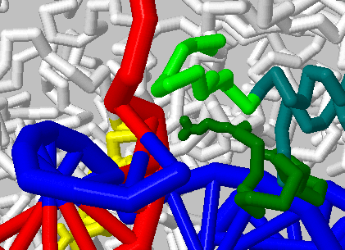
Following NTP Through β’
The lid cleaves the RNA-DNA hybrid, directing the RNA strand to the exit channel.

Slide 14
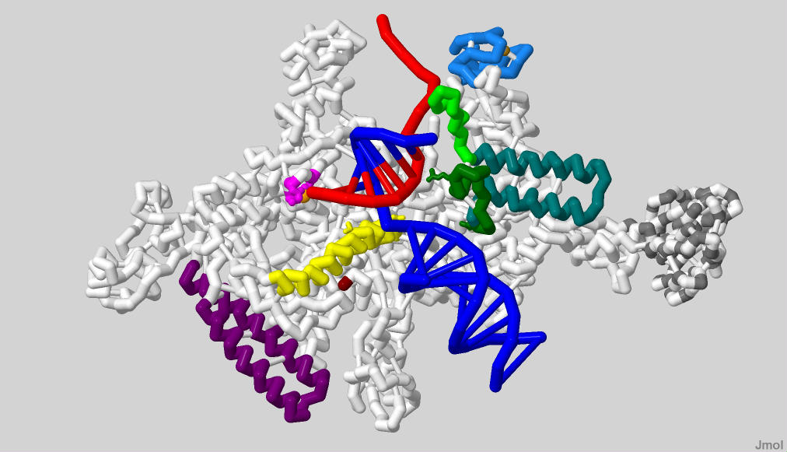
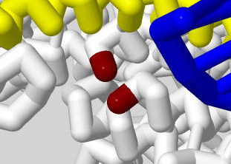
T. thermophilus B’ subunit

Slide 15
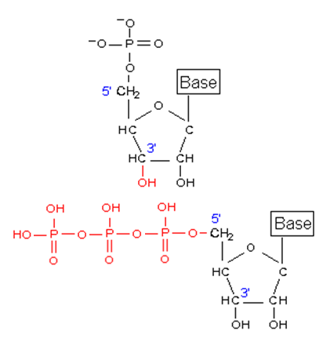
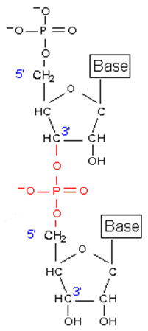
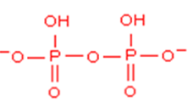
RNA Structure and Synthesis
γ
β
α
Pyrophosphate

Slide 16
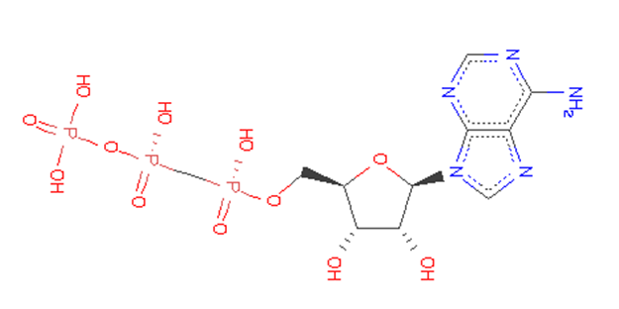
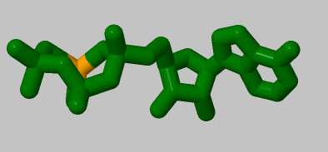
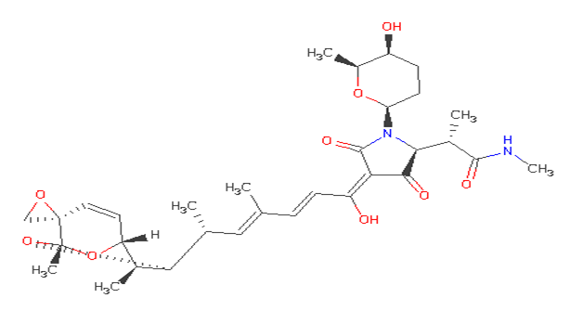
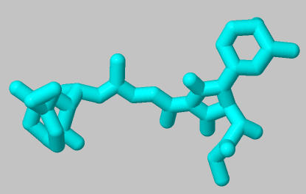
Non-hydrolysable nucleotide
(AMPcPP)
Streptolydigin (Inhibitory antibiotic)

Slide 17
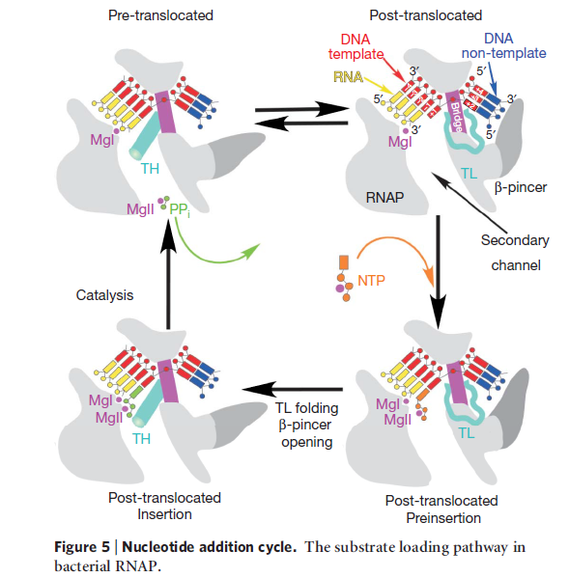
Substrate Loading Mechanism
(Vassylyev, 2007)

Slide 18
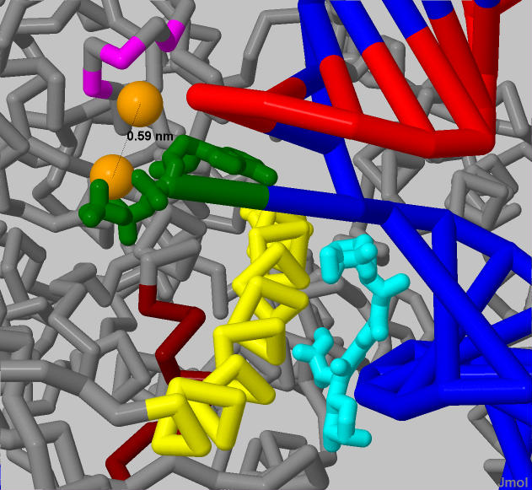
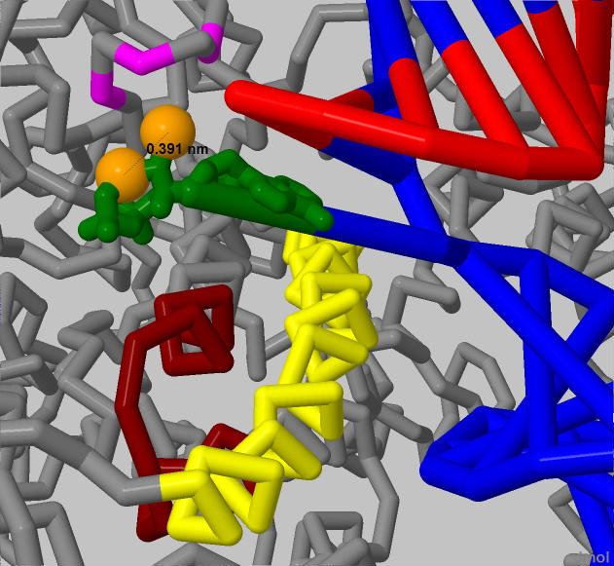
Nucleotide Orientation
With a non-hydrolysable nucleotide and streptolydigin, Pre-insertion state
With a non-hydrolysable nucleotide
(AMPcPP), Insertion state
(PDB file 2PPB)
(PDB file 2O5J)

Slide 19
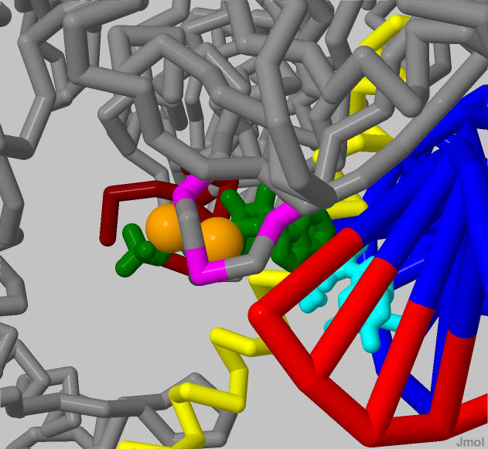
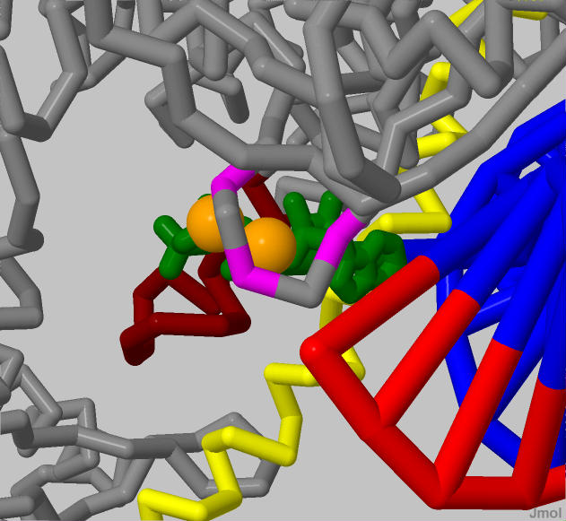
Transition of Trigger Loop (TL) to Trigger Helix (TH)
With a non-hydrolysable nucleotide and streptolydigin, Pre-insertion state
With a non-hydrolysable nucleotide
(AMPcPP), Insertion state
(PDB file 2PPB)
(PDB file 2O5J)

Slide 20
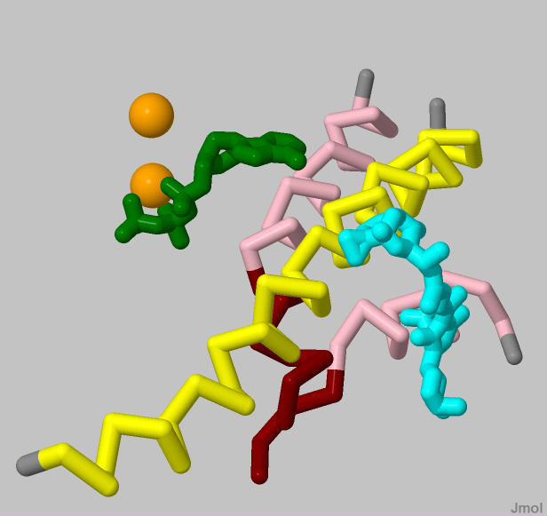
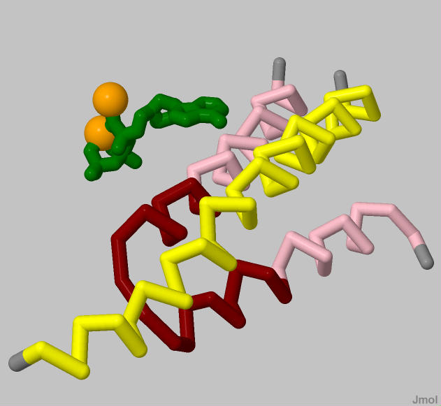
Transition of Trigger Loop (TL) to Trigger Helix (TH)
With a non-hydrolysable nucleotide and streptolydigin, Pre-insertion state
With a non-hydrolysable nucleotide
(AMPcPP), Insertion state
(PDB file 2PPB)
(PDB file 2O5J)

Slide 21
Summary
RNAP operates as a molecular machine with many distinct components contributing specific functions.
Several regions are highly similar in the B’ subunit of prokaryotic and eukaryotic RNAPs suggesting a high degree of functional conservation.
Channels and structures involved in nucleotide addition and RNA-DNA hybrid cleavage have been identified
The discovery of the TL to TH transition has enhanced our understanding into the mechanistic function of RNAP and has presented a possible new drug target.

Slide 22
Acknowledgements
Educator:
Dr. Steven Forst, UW-Milwaukee
Mentor:
Dr. Richard Gourse, UW-Madison
Dr. Margaret Franzen, MSOE
Dr. Tim Hudson, MSOE
Mark Hoelzer, MSOE
Funding- NSF Grant

