Slide 1
RNA Polymerase
Marvin H. O’Neal III, PhD
Wali Karzai, PhD
Ke Shang, Class of 2012

Slide 2
Approach
Select problem child

Slide 3
Student outcomes in 300-level BIO courses at Stony Brook
Course (year) | Total # of students | % < C (SBU pre-req) | % < C (Comm. Coll. pre-req)
BIO317 (‘09, ‘10) | 418 | 9% (32/344) | 27% (7/26)
BIO325 (’08 - ’10) | 815 | 22% (120/551) | 41% (48/118)
BIO361 (‘08 – ’10) | 821 | 33% (225/684) | 54% (27/50)
BIO311 (lab) (F ‘10, S ‘11) | 135 | 8% (7/89) | 14% (2/14)
BIO335 (lab) (‘09, ‘10) | 173 | 2% (3/143) | 0% (0/4)
BIO344 (lab) (‘08 – ’11) | 414 | 10% (30/288) | 27% (18/66)
Note: 38% (25/65) of Stony Brook students who took these upper division courses without the pre-requisites got a D or an F in the course.
Notes:
Have detailed information on all six courses.
3

Slide 4
Approach
Select problem child = BIO362 BioChemistry II
Course director selects challenging topic
Develop out of class learning activity:
  3D tactile model
  Proteopedia page w/ video, green links
  Worksheet
  Outside faculty member
  Survey
Test students using midterm and final exam
Compare participants to non-participants

Slide 5
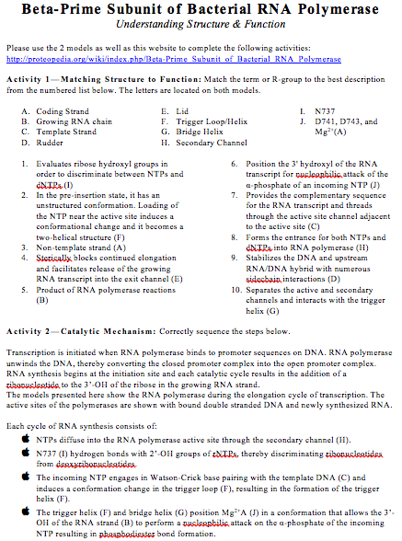

Slide 6
10 mins | Yes | It was helpful as is | Yes | No
10 mins | Yes | Interesting. Would be nice to have some more figures + the current model to help illustrate some certain ideas. | Yes | Yes
15 mins | Yes | everyone was fine | No | No
15 mins | Yes | with a toy, it provides a better view of RNAP | No | Yes
15 mins | Yes |  | Yes | No
15 mins | Yes |  | Yes | No
15 mins | Yes | The physical model was good. | Yes | No
15 mins | Yes | Seeing the 3d model of rnap was extremely helpful. I don't have any negaticve critiques. | Yes | Yes
20 mins | Yes | I found that the videos are a good resource to get to know how the model works, but after going through the video a few times I found that the worksheet could have easily been done without the models or the video, and just reading the Proteopedia website. | Yes | No
20 mins | Yes | The RNA polymerase model and explanation videos definitely help with identifying the various parts of RNAP. Still, the information is very dense and finding someway to make it easier to understand would be helpful.Also, it would help to label the three unattached pieces; the D741/D743/Mg2+ piece is pretty hard to locate on the RNAP model! | Yes | No
20 mins | Yes | Physically touching and moving the models helped with the visualization and activity. The video web page audio was not working at my station. I would have liked it if the models were broken down even further, and we had to piece the components together. | Yes | No
20 mins | Yes | The model was very helpful in understanding how RNA polymerase works. Helped me understand the interactions that occur within the active site allowing me to understand transcription better. | Yes | No
20 mins | Yes | I got a better understanding of the orientation of RNA polymerases and the different subunits within the complex. Also got a better understanding of the what each structure does during transcription. | Yes | No
20 mins | Yes | We learn so much detail in class so it was nice to just get a quick overall view of whats happening. | Yes | No
20 mins | Yes | It was helpful because it helped understand the process visually. | Yes | No
20 mins | Yes | I can visualize how the protein/enzyme functions usiing the aids and the videos. This will help me remember pertinant information in more ways than one. | Yes | Yes
>20 mins | Yes | his activity was extremely detailed and helped me visualize the actual RNAP complex in a more realistic way. It also helpede understand the critical points of each component of the complex, especially Asparagine737. The model does not show the holoenzyme which can be confusing if one wants to label or identify it on the model. | Yes | No
>20 mins | Yes | It was very interactive and made me think a lot. | Yes | No
>20 mins | Yes | What I like about this activity is that using the model I can get a better depiction of the RNAP along with its subunits, the important R-groups along with their function. It helped me gain a better understanding of how the RNAP functions and work as well. | Yes | No

Slide 7
Data
Participants midterm exam average: 3.78, n=23
Non-participants average: 2.52, n=108
Survey = positive feedback and no correlation between exam scores and performance-based questions on worksheet

Slide 8
Ghost of data yet to come
Performance on final exam question
Performance between participants/non-participants on material NOT covered by activity

