Slide 1

MCAD
Medium Chain Acyl-CoA Dehydrogenase:
The Answer to Some SIDS Cases
Mount Mary College
Students: Jessica Benson, Amy Ramirez, Nerissa Seward
Faculty Advisor: Dr. Colleen Conway
Medical College of Wisconsin
Research Mentor: Dr. Jung-Ja Kim

Slide 2
Our Focus
Medim Chain Acyl-Coenzmye A dehydrogenase (MCAD)
Flavin Adenine Dinucleotide (FAD)
Electron Transferring Flavoprotein (ETF)
Enzymes catalyzes the rate of reaction
Multiple Intermolecular Interactions

Slide 3
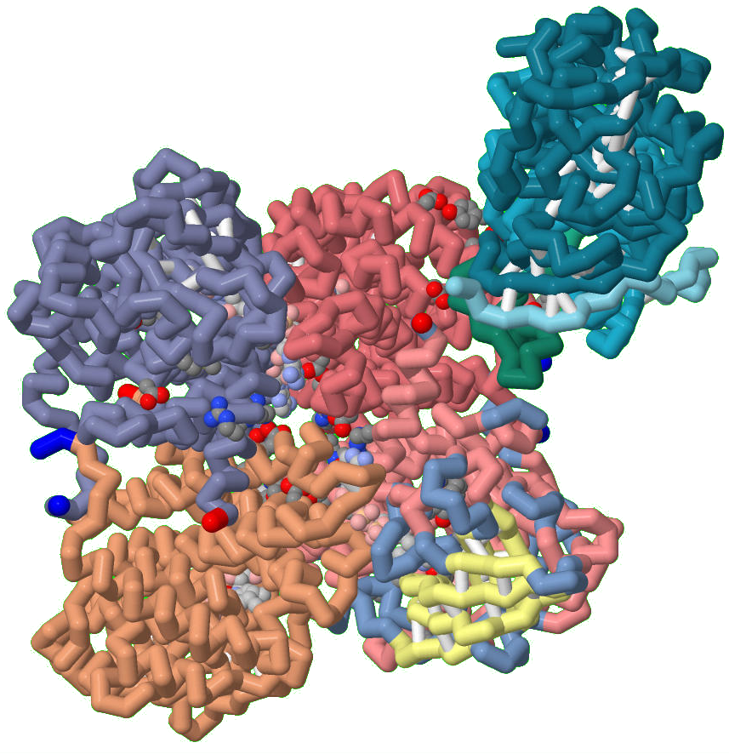
MCAD
Notes:
For explanation, point out that there are four identical subunits with an electron transferring falvoprotein and is found in mitochondria

Slide 4
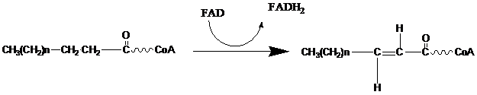
Degredation of Fatty Acids
Substrate:
Fatty Acid with ‘n’ number of carbons
Enzyme:
MCAD
Product:
Acyl-
Coenzyme A
Other Common Members of the Dehydrogenase Family:
Very long chain Acyl-CoA
Long chain Acyl-CoA
Short chain Acyl-CoA
Notes:
MCAD is first enzyme in the fatty acid beta oxidation spiral that degrades fatty acids into Acetyl-Coenzyme A. MCAD is one of a family of nine dehydrogenases that breakdown different lengths of carbon chains of fatty acids in beta oxidation spiral. MCAD works on fatty acids of 4-12 carbons in length.

Slide 5
MCAD Active Site
Accommodates substrates
Binding the FAD
Important Amino Acid
  Glutamate-376
MCAD
Substrate
Once the substrate is bound to the active site MCAD is able to catalyze the reaction
Glu
FAD
Notes:
Accommodates substrates up to twelve carbons long
Binds the FAD at its flavin ring, specifically at the 2'-OH of the ribityl chain
Glutamate-376 is the catalytic base and, the substrate binds to it at the amide nitrogen

Slide 6
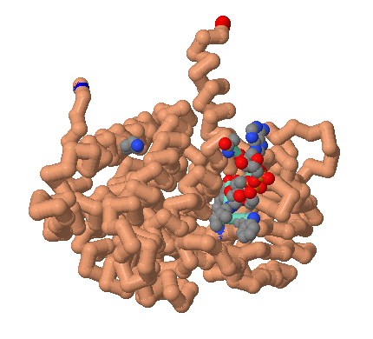
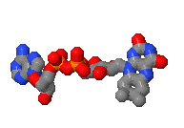
Flavin Adenine Dinucleotide
Function
Isoalloxazine Ring
Interactions
Notes:
Flavin Adenine Dinucleotide, more commonly known as FAD, is present in all four subunits of MCAD. In my subunit I illustrated some of the intermolecular interactions that occur. FAD is the plum colored structure with the three rings. The lines that connect FAD to the MCAD are hydrogen bonds. There are also hydrophobic interactions as well as interactions with neighboring residues, but I only illustrated the hydrogen bonds because they are thought to be the most essential. As you can see there are hydrogen bond interactions between MCAD and FAD throughout the model but the bonds on the three member ring is key to the function. The function of FAD is to transfer electrons between MCAD and FAD. The exact mechanism of this is unknown but the three member ring is the most important.

Slide 7
Electron Transfer between MCAD and FAD
MCAD
e
e
e
e
e
FAD
e

Slide 8
Electron Transferring Flavoprotein
Structure and Interactions
  FAD and 3 domains
  ETF and MCAD
    Docking
Function
  Accepts and transports electrons
Mutations
  Electron transfer is inhibited
Notes:
Structure:
It is a heterodimer protein that folds into 3 domains
FAD is non-covalently bonded to domain 2 and is in the shallow bowl between domain 1 and 3
There are different interactions between ETF and FAD:
Salt bridges
Hbonds
Interactions between residues of ETF and MCAD along with FAD interacting with ETF
Function:
In mammals ETF links the activity of about 10 different dehydrogenases to respiratory chain by accepting and then transferring electrongs to membrane bount ETF-ubiquinone oxidoreductase-ETF acts like cytc because it carries and transfers electrons to ETC
Evidence suggests that electron transfer from MCAD to ETF requires a rotational movement of ETF FAD domain-the movement is restricted by a static componenet of interaction (small residue leu194 on domain 2 of ETF)
Therefore there are 2 opposing things:
1. etf retains specificty via leu195 interaction in domain 3
2. etf retains flexibility by the flexible FAD domain
ETF and MCAD:
There are 2 interactions between ETF and MCAD- one is at leu195 on ETF that is an anchor and docks onto the hydrophobic patch on MCAD surface
Residue near surface may interact with arg249 in ETF and FAD domain and stabilize conformation for electron transfer from primary dehydrogenase to ETF
ETF FAD and MCAD FAD are in close proximity and this allows for fast interprotein electron transfer
Need glu212 in MCAD to stabilize electron transfer state and glu165 in ETF is also required
ETF has dual contact mechanism (?)
Docking:
Hydrophbic pocket formed by phe23, gly60, thr64, leu73, leu75 and ile83 on MCAD
Hydrophobic pactch extends to ETF with residues tyr192, pro 197, ile198 and met199
The docking is an induced fit binding for ETF and the changes occure in ETF not in MCAD
On ETF there is a rec loop from ile14 to ser37 and it is able to recognize the hydrophobic patch on MCAD
The results in concomitant rearrangement of tyr16 on ETF from its normal position near FAD isoalloxazine ring…leu195 on ETF and the rec loop are necessary for correct docking with MCAD
Mutations:
Any mutations result in no electron transfer-mutations can be on the following:
Mutation of Glu212 to ala disrupts salt bridge centered on arg249alpha
Mutation of Arg249alpha to ala also affects this salt bridge
Mutation of glu359 to either gln or ala also disrupts salt bridge
Mutation of trp166 to phe or ala decrease electron transfer
Mutation of tyrpsine-360 to ala removes the stacking interaction and affects the electron transfer rates
Glu165 forms a transient interaction between FAD domain and surface ETF contributed by domain 1 and 3

Slide 9
-Unbound ETF
-Loop recognizes Hydrophobic Pocket of MCAD
ETF
FAD
ETF
FAD
e
e
Leu
e
FAD
FAD
MCAD
MCAD
-Bound ETF
-Interactions between the Proteins Present
-Electrons are transferred from MCAD to ETF

Slide 10
Our Focus
Intermolecular Interactions Modeled in MCAD, FAD and ETF
MCAD
FAD
ETF
Active Site:
Glu376, Glu199, Leu103, Ser142, Met249, Asp253, Arg388
Folding of MCAD:
2 Dimers Combine:
Arg28:A and Glu86:D
Tetramer:
Lys304, Glu300,
Gln342, Asp346,
Arg383
The following MCAD residues hydrogen bond to different atoms of FAD:
Gln380
Trp166
Tyr133
Thr168
Thr136
Ser142
Hydrogen Bonds:
MCAD ETF
Gly60 and Leu95
Thr26 and Ala193
Glu34 and Tyr192
Glu22 and Thr77
Ionic Interactions:
MCAD ETF
Glu18 and Arg76
Recognition Loop:
Ile14 to Ser37

Slide 11
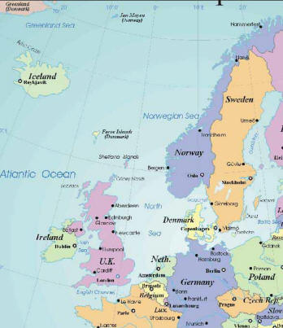
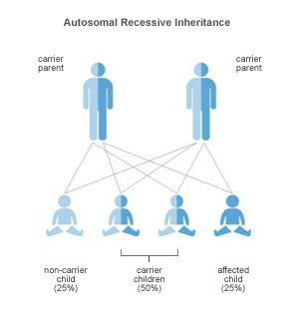
MCAD Deficiency
Autosomal recessive mutation
Sudden Infant Death Syndrome (SIDS)
Prevalence
Notes:
MCAD Deficiency is an autosomal recessive mutation which means that the mutated gene was inherited from either one of both of the parents. The mutation that occurs is a base pair mutation that changes an adenine to be changed to a guanine which causes the amino acid to be changed from lysine to a glutamate. 80% of all cases are homozygous for the mutation. When someone is homozygous for the mutation is simply means that the mutated gene was inherited from both the mother and father. 18% of all cases are heterozygous for the mutation which means that the child only inherited one mutated gene. This could have came from both the mother or father, but not both.
Sudden Infant Death Syndrome, more commonly known as SIDS, is when the cause of death of an infant cannot be explained. Research indicates that roughly 1% of SIDS cases, were actually caused by MCAD deficiency.
The prevalence of MCAD deficiency is that it is most common in northern European countries. Some of the countries that MCAD deficiency is most common in is England, Ireland, and Scandinavia. Australia also has an increased number of MCAD deficiency cases.

Slide 12

MCAD Deficiency
Screening
Symptoms
Treatment
Notes:
Screening for MCAD deficiency is universally required by law or rule and fully implemented in the United States which means that every child born in the United States is tested for MCAD deficiency. Under circumstances that a child is not screened for MCAD deficiency, such as being born in another country, infants are tested when both parents carry the gene or if the infant shows symptoms of the deficiency. The tests used to determine whether a child has MCAD deficiency is tandem Mass Spectrometers (MS) or a Polymerase Chain Reaction (PCR). Prenatal test can be done if both parents carry the mutated gene.
Symptoms occur when individual is in fasting state. Common symptoms are hypoglycemia, vomiting, lethargy, liver dysfunction, seizures, and coma. When individual is not treated, can result to brain damage, cardiac arrest, and death.
Treatment includes not fasting for more than two to six hours. Individuals with MCAD deficiency should consume a high carbohydrate diet with low fats. Intravenous glucose is given if unable to consume food. Some doctors choose to give patients supplemental carnitine.

Slide 13
Future Research
FAD
Other Metabolic Disorders
  Other members of the Acyl-CoA Dehydrogenase family
Amino acid residues of MCAD
Notes:
Further research on FAD should be conducted because researchers currently know that the isoalloxazine ring is key in the transferring of the electrons but the mechanism of transferring electrons is not understood.
MCAD is one type of metabolic disorder which is occurs in the second step of the beta oxidation of fatty acids. Another type of metabolic disorder is Trifunctional Protein (TFP) Deficiency. This metabolic disorder involves the last three steps of the beta oxidation of fatty acids. Additional research on other family members of the Acyl-CoA Dehydrogenase could also prevent further deaths. There are many similarities between MCAD and their other family members but the differences are not fully understood. It is possible that other metabolic disorders may be a small percentage of SIDS cases.
Amino acid residues necessary for catalysis and correct function of MCAD has been used to compare to other members of the family.
Although not all SIDS deaths are due to mcad…maybe they are related to the other enzymes in the fatty acid beta oxidation

Slide 14
Acknowledgments
Center for Biomolecular Modeling
  Dr. Margaret Franzen
Medical College of Wisconsin
  Dr. Jung-Ja Kim
Mount Mary College
  Sciences Department
National Science Foundation Grant
  DUE-1022793

